Slide 1
New York Derby
Exploratory Data Analysis

Slide 2
Overview
New York Racing Association (NYRA) and the New York Thoroughbred Horsemen’s Association (NYTHA) conduct world class thoroughbred racing at Aqueduct Racetrack, Belmont Park, Saratoga Race Course.

Slide 3
Outline of the Analysis
Races
Race Tracks
Race Schedule
Number of:
races on a track.
races in a day.
horses in a race.
Shape and size of:
each race track.
Timetable of:
races per month.
races per week.

Slide 4
Understanding the Data

Slide 5
Horse Racing
Trivia!
Furlong: imperial measure of distance in; 201 meters approx.
Turf: racing surface of consisting of grass
Maiden Race: horses who have not won a race
Claiming Race: horses are for sale before the race
Stakes Race: some amount of prize is put up by horse owners.

Slide 6
Races

Slide 7
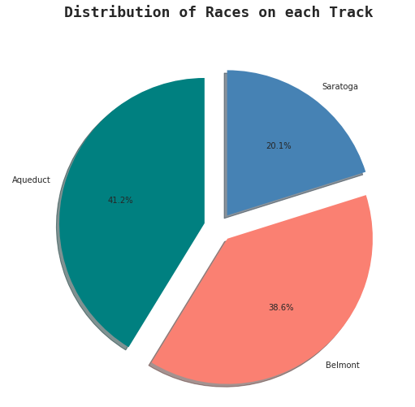
Races
One in five races took place at Aqueduct.

Slide 8
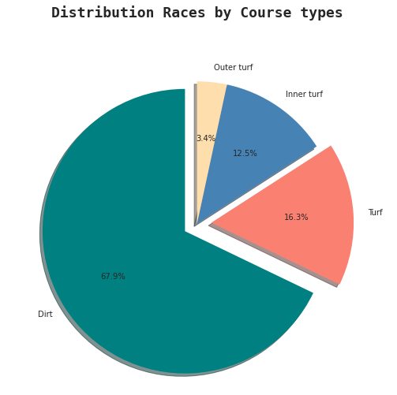
Races
More than two-thirds of the races were on Dirt course type.

Slide 9
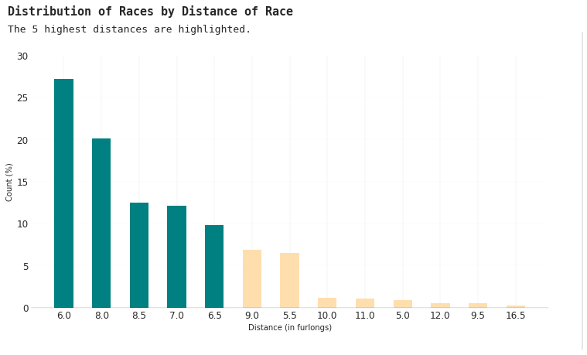
Races
Insights
Distance of races ranges from 4.5 to 14 furlongs.
6 to 8.5 furlongs were the 5 most frequent distances.
More than one-fourth races were in 6 furlongs.
Less than ten percent of the races were above 10 furlongs.

Slide 10
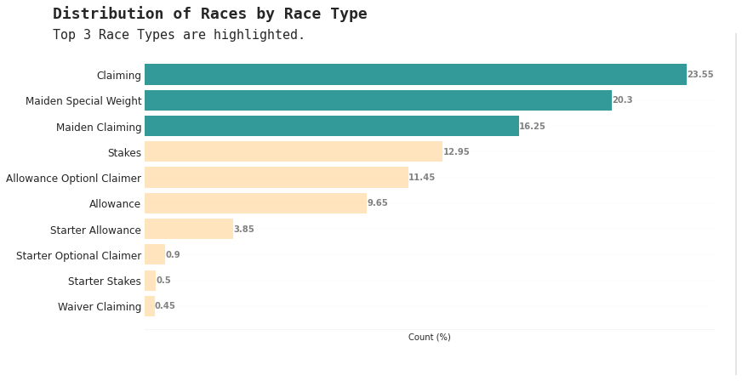
Races
Insights
Claiming races accounted for more than 23% races.
Maiden Special Weight races accounted for around 20% races.
Maiden Claiming races accounted for 16% races.
Stakes race accounted for about 13% races.

Slide 11
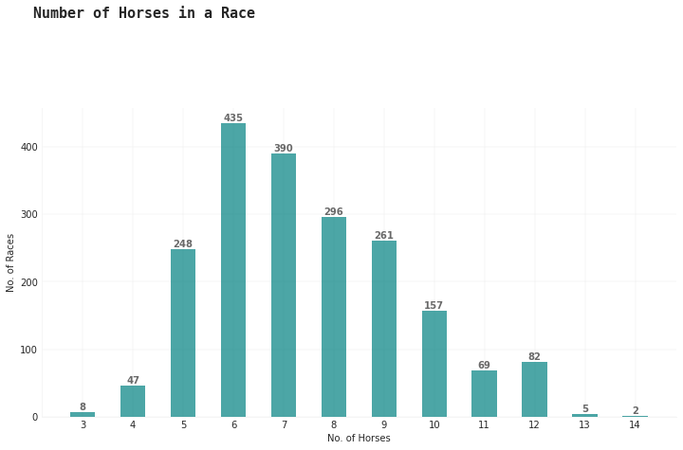
Races
Most races tend to have 5 to 12 horses.

Slide 12
Race Tracks

Slide 13
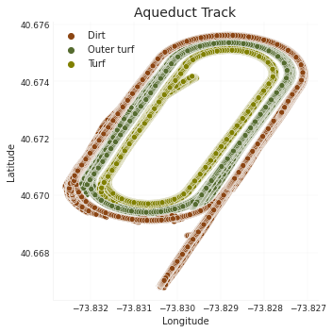
Race Tracks
Aqueduct
Inside of the Main (Dirt) track are two courses: the Main Turf Course, and the Inner Turf Course.

Slide 14
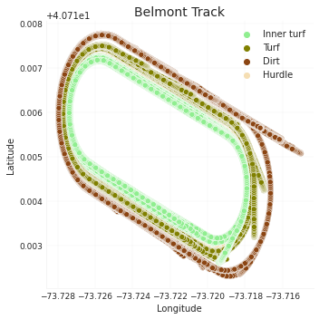
Race Tracks
Belmont Park
The Main (Dirt) Track surrounds the Turf Course, which in turn encircles an Inner Turf Course that also includes hurdles.

Slide 15
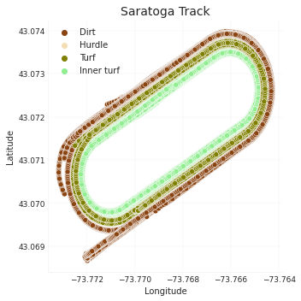
Race Tracks
Saratoga
There are three separate tracks in the main course at Saratoga: a Main (Dirt) Track, a Turf Track, and an Inner Turf Track, including hurdles.

Slide 16
Race Schedule

Slide 17
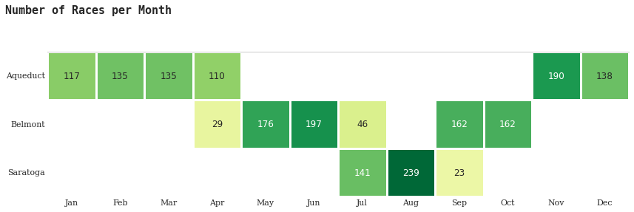
Race Schedule
Insights
Aqueduct: races took place from Nov-Apr.
Belmont: races in May-Jun, Sep-Oct, and a few in Apr and Jul.
Saratoga: races only from Jul-Sep.

Slide 18
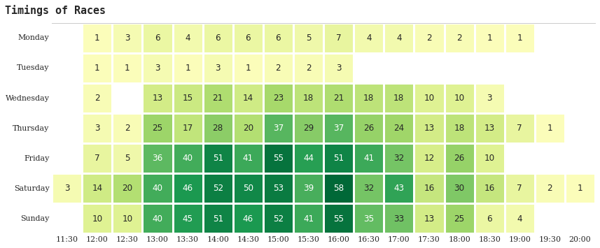
Race Schedule
Insights
Throughout the year, most races took place on Friday and the weekend.
A few races were on Mondays and Tuesdays, during holidays.

Slide 19
Sources
Dataset
Big Data Derby- Kaggle
Code
On GitHub
References
Histograms
Pandas

Slide 20
Thank You!
Project By:
Shagun Dwivedi

